Slide 1
Using machine learning to detect suspicious DNS requests
Tyler Harrison

Slide 2
Introduction and problem statement
The rise of cyber threats and scams has made it increasingly difficult to identify and protect against malicious domains. Machine learning offers a potential solution to this problem by allowing us to automatically analyze the characteristics of a domain and predict whether it is legitimate or potentially harmful.
In this project, I used machine learning to detect suspicious domains and evaluate the performance of different algorithms in doing so. This helps to better understand the effectiveness of machine learning in identifying potential threats and provide a valuable tool for protecting against cyber attacks.

Slide 3
Dataset summary
“Using the domain name as input, 34 features were obtained. Features like the domain name, entropy, number of strange characters and domain name length were obtained directly from the domain name. Other features like, domains name creation date, IP, open ports, geolocation were obtained from data enrichment processes (e.g. OSINT). This dataset consists of data from 90000 domains names and it is balanced between 50% non-malicious and 50% of malicious domain names.”
https://data.mendeley.com/datasets/623sshkdrz/5

Slide 4
Data pre-processing and feature engineering
Needed to slim down the data to 500 entries in order to do computation on a laptop instead of a dedicated server with a GPU
Limited classifiers to the following because of how complex mapping words/strings to numbers is:
ConsonantRatio
NumericRatio
SpecialCharRatio
VowelRatio
ConsonantSequence
VowelSequence
NumericSequence
SpecialCharSequence
DomainLength

Slide 5
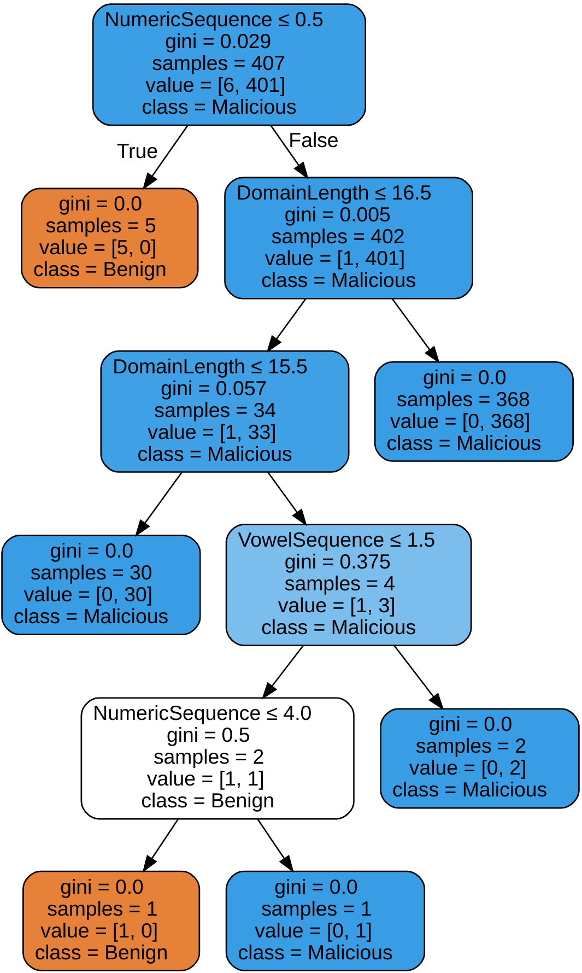

Slide 6
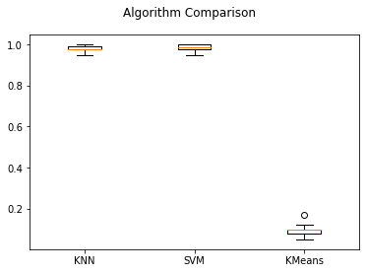
Machine learning applications and results
Used K-Nearest-Neighbor, K-Means and SVC
KNN and SVC performed significantly better than SVC

Slide 7
Machine learning applications and results
KNN: 0.9901960784313726
SVC: 0.9705882352941176
K-Means: 0.09803921568627451

Slide 8
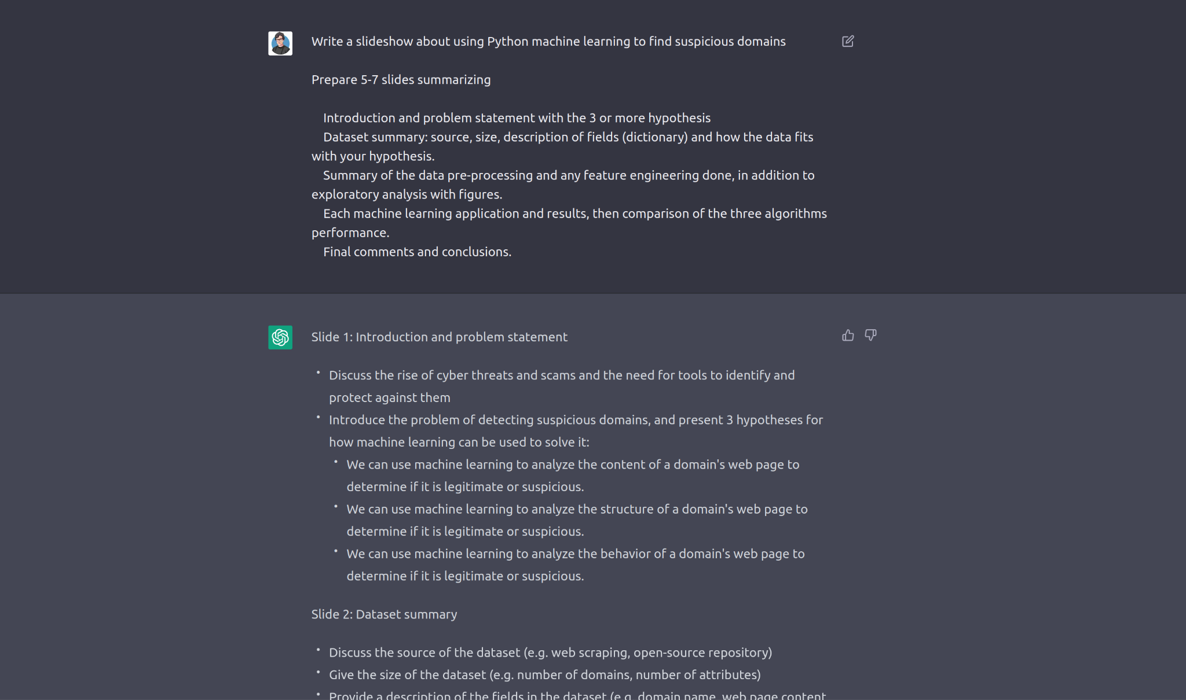

Slide 9
Discussion and conclusion
It does appear to be viable to use DNS query information to predict suspicious domains
KNN and SVC were significantly more effective machine learning models for this specific application than K-Means
More work needs to be done to account for the omitted classifiers
Need to try the larger dataset on the new ML GPUs Dr. Hammad just got
GPT-3 is very useful for writing slideshows

